Slide 1
Predicting the Chances for Opening an Italian Cuisine Restaurant IN CANADA
SOWMYA.C 31 DEC 2020

Slide 2
PROBLEM STATEMENT
Italian Cuisine is the most loved cuisine in the world.
This Cuisine is loved by the Canadians as well so we have to predict the perfect place for the setup and central place.
crowd attention and limited access.
Top loved foods
uses the machine learning techniques, four square API and the capstone.

Slide 3
DATA
Total restaurants in Canada
Area that has less Italian restaurant.
Centralized area for setup
Population in particular area
Most loved Italian Cuisines

Slide 4
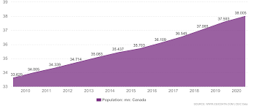

Slide 5
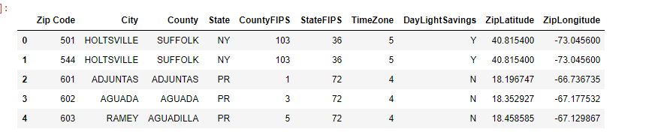

Slide 6
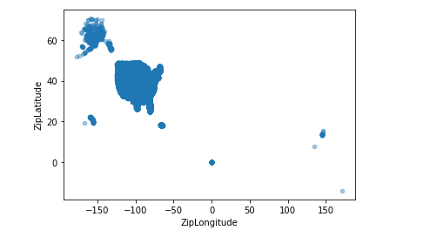
The above data are to collected using geocoding and foursquare API.

Slide 7
METHODOLOGY
Foursquare
location and type
Geocoding
calculation and exploration of population and restaurant density :
K-Means clustering
Most promising areas

Slide 8
ANALYSIS
Total number of restaurants.
The Italian restaurants are then counted.
Heat map is used to locate them.
Top running hotels are taken .
Areas with less Italian restaurants are noted.

Slide 9
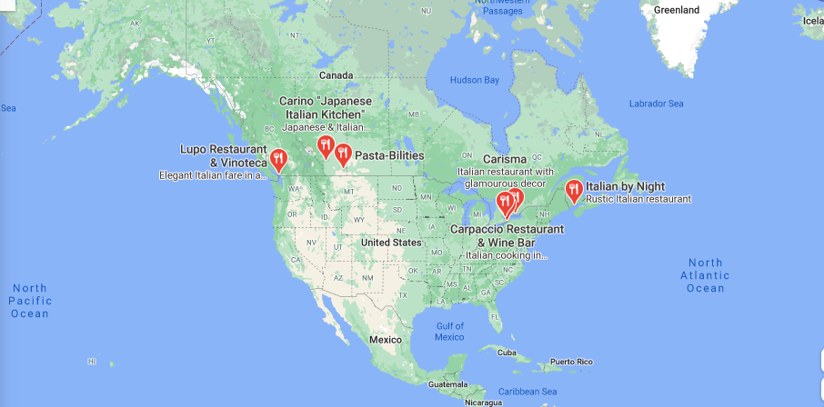

Slide 10
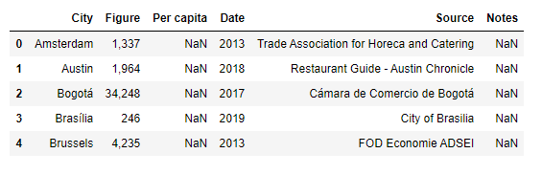

Slide 11
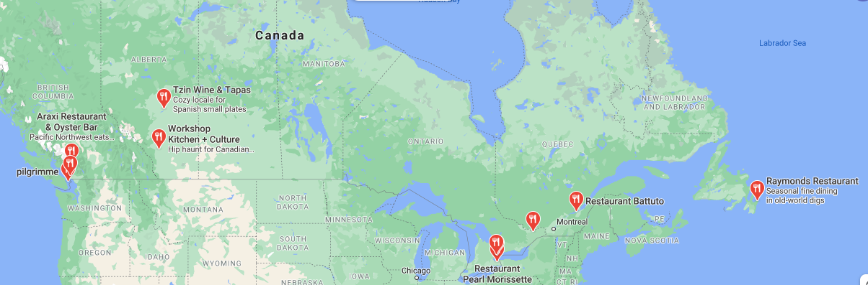

Slide 12
RESULTS AND DISCUSSIONS
Here based on the population density and central areas some restaurants are selected and then based on the facts worst running Italian restaurants and places with no Italian restaurants some places are selected.
Result of all this is 10 zones containing largest number of potential new restaurant locations based on number of and distance to existing venues - both restaurants in general and Italian restaurants particularly. This, of course, does not imply that those zones are actually optimal locations for a new restaurant.
Purpose of this analysis was to only provide info on areas close to Canada center but not crowded with existing restaurants (particularly Italian) - it is entirely possible that there is a very good reason for small number of restaurants in any of those areas, reasons which would make them unsuitable for a new restaurant regardless of lack of competition in the area.
Recommended zones should therefore be considered only as a starting point for more detailed analysis which could eventually result in location which has not only no nearby competition but also other factors taken into account and all other relevant conditions met.

Slide 13
CONCLUSION
The area suitable for a Italian restaurant in Canada has to be chosen.
less number of competitive restaurants, population, people taste, quality and so on.
The central part that satisfies all the constraints has been selected through k-means clustering, Geocoding , Foursquare API and Google API.
The analysis has been made completely based on machine learning and clustering whereas the setup include other factors like design, construction, money, quality, noise and so on which has to be decided by stakeholders

Slide 14
THANK YOU!

